Slide 1
Gears and Gear Train

Slide 2
Gears
Gear can be defined as a toothed wheel that can be engaged in another toothed wheel in order to transmit energy that gives the change of speed and direction of motion.
It is widely used in mechanical devices. The teeth of the gear are generally carved on wheels, cylinders, or cones.
The tooth and wheel of gear are working parts of all types of gears. The different types of gears are used to complete the transfer of energy in different ways and in different directions.

Slide 3
Gears
A gear is a component within a transmission device that transmits the rotational force to another gear or device.
Gear is different from a pulley in that a gear is a round wheel that has teeth that mesh with other gear teeth thus Allowing the force to be fully transferred without slippage.
Depending on their construction and arrangement, geared devices can transmit forces at different speeds, torques, or in a different direction, from the power source.

Slide 4
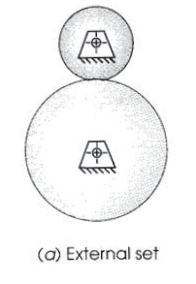
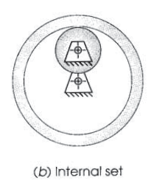
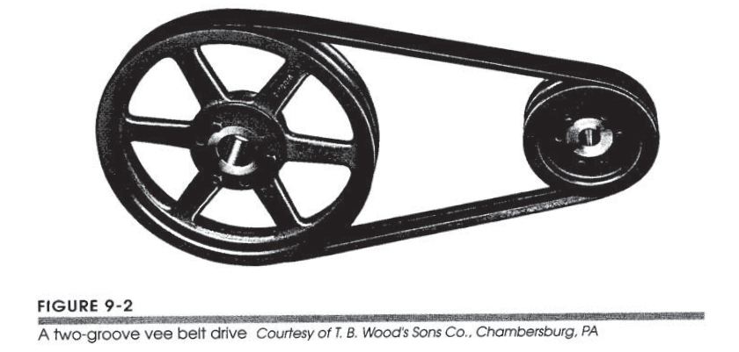
Rolling Cylinders & Vee belt drive

Slide 5
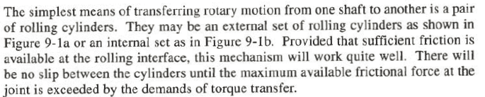
Rolling Cylinders

Slide 6
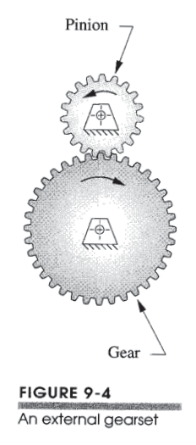
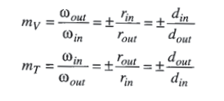
Fundamental Law of Gearing:
The angular velocity ratio between the gears of a gearset remains constant throughout the mesh.
Where mv is angular velocity ratio and Mt is the torque ratio.

Slide 7
Types of gears
Parallel Axis Gears
In this type of gearing, the axis of both the gears tends to be Parallel to each other.
Perpendicular Axis Gears
In this type of gearing the axis of the gears tend to be perpendicular to each other.
Non-intersection perpendicular axis
In this type, the two perpendicular axes of the gearing do not intersect each other.
Intersection Perpendicular Axis Gear
In this type, the perpendicular axis of the gears tends to intersect at a certain point.

Slide 8
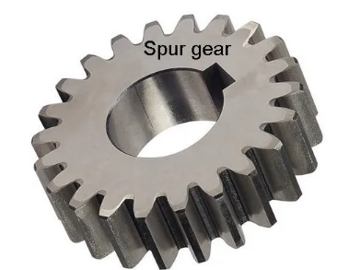
Types of gears: Spur gear
They have straight teeth and are mounted on parallel shafts and their general form is a cylinder or disk.
The teeth project radially, and with these “straight-cut gears”.
When two spur gears of different sizes mesh together, the larger gear is called a wheel, and the smaller gear is called a pinion.
It is generally used for the transmission of rotary motion between parallel shafts.

Slide 9
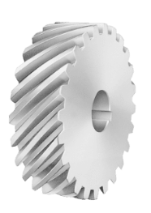
Types of gears: Hellical gear
The teeth of a helical gear are set at an angle (relative to axis of the gear) and take the shape of a helix.
The teeth of a helical gear are not parallel to the axis of rotation but are set at a helix angle. Helical gears can be meshed in a parallel or crossed orientation.
Along with parallel helical gear, each pair of teeth first contacts one point on the one side of the gear wheel.
A moving curve of contact increases gradually against the teeth face to a maximum then comes back until the teeth reach contact at one point on the opposite side.
The use of helical gears is indicated when the application involves high speeds, large power transmission, or where no noise is important.

Slide 10
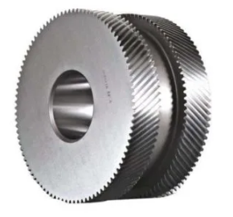
Types of gears: Double Hellical gear
A double helical gear is a type of helical gear that has right and left-hand teeth on a single gear.
It consists of two faces of helical gears placed next to each other and separating them from each other.
Double-helical gears will eliminate thrust load and allow for more significant tooth overlap and smooth operation.
In addition, it provides an additional shear area on the gears which is necessary for further high torque transmission.

Slide 11
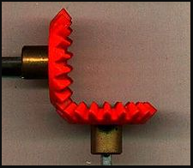
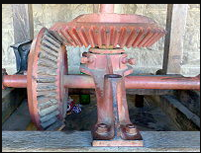
Types of gears: Beval gear
Bevel gears are gears where the axes of the two shafts intersect and the tooth-bearing faces of the gears themselves are conically shaped.
The connecting shaft is generally at 90°and sometimes one shaft drives a bevel gear which is mounted through the shaft resulting in two output shafts. The point of intersection of the shaft is called the apex and the teeth of the two gears converge at the apex.
Bevel gear transmits power between two intersecting shafts at any angle.

Slide 12
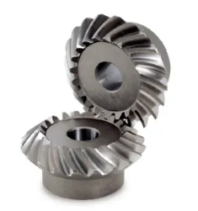
Types of gears: Mitre gear
It is a particular bevel gear designed to operate in pairs with the same number of teeth, diameter pitches, and 1:1 ratio. These are used to change the direction of power transmission without changing the speed.
In addition to the standard miter gear with a 90° angle shaft, a miter gear with any other shaft angle is called an angular miter gear.

Slide 13
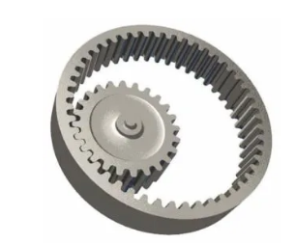
Types of gears: Internal gear
In this type of gear, the inner gear has teeth cut on the inside of the cylinder and paired with the outer gear.
Internal gears are mainly used for planetary gear drives and gear-type shaft couplings.

Slide 14
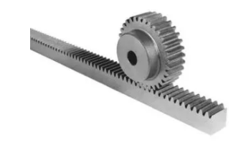
Types of gears: Rack and Pinnion gear
A rack and pinion is a pair of gears that convert rotational motion into linear motion and vice versa. A circular gear called “the pinion” engages teeth on a linear “gear” bar called “the rack”.
Rotational motion applied to the pinion will cause the rack to move to the side, up to the limit of its travel. The diameter of the gear determines the speed that the rack moves as the pinion turns.
A rack and pinion are commonly found in the steering mechanism of cars or other wheeled, steered vehicles.

Slide 15
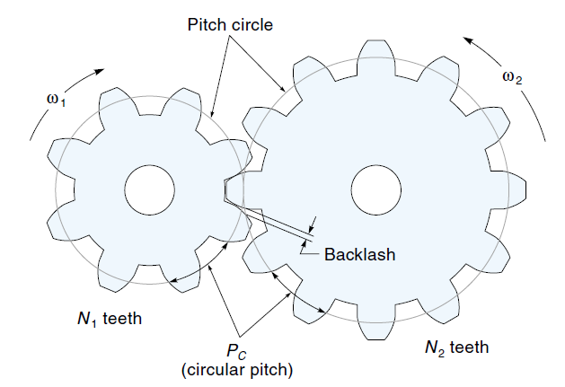
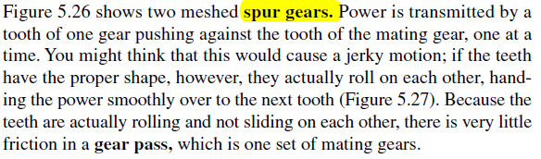

Slide 16
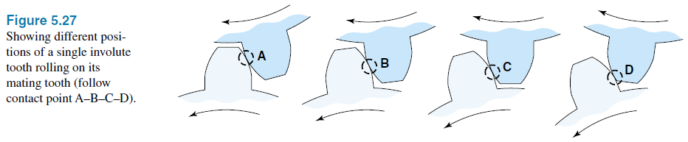
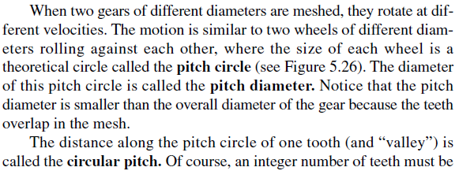
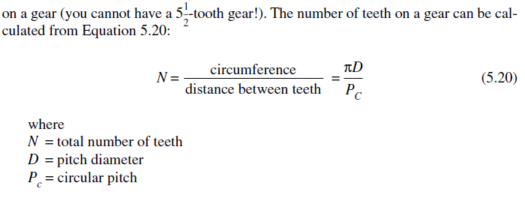

Slide 17
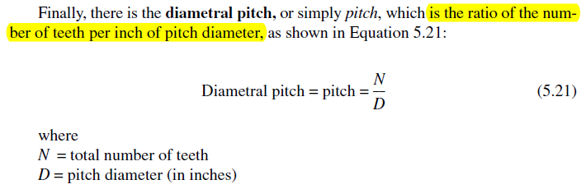

Slide 18
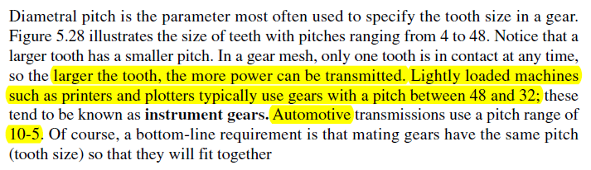
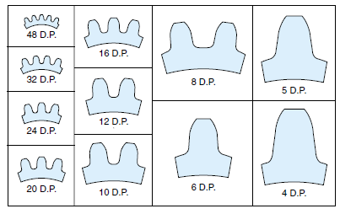

Slide 19
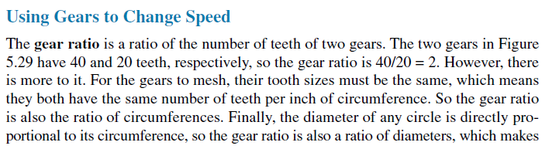
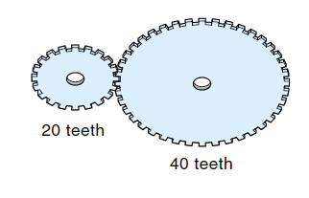

Slide 20
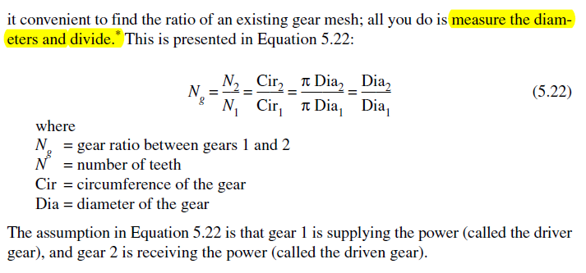

Slide 21
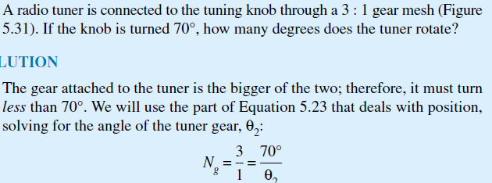
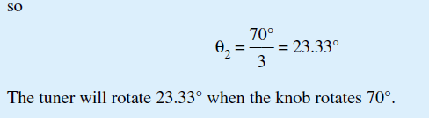
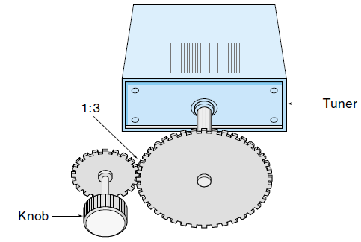

Slide 22
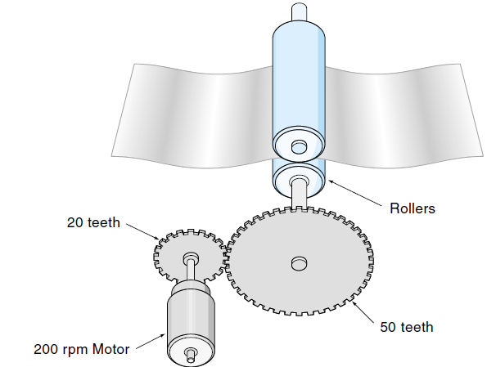
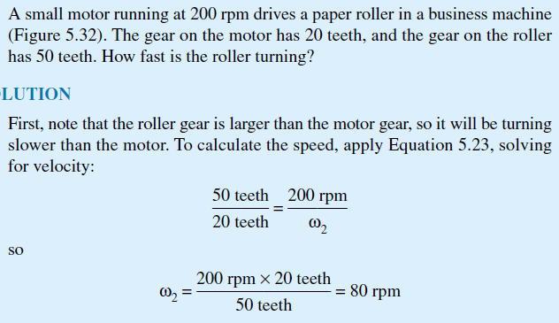

Slide 23
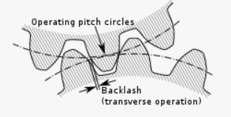
Back Lash in Gears
Backlash, a clearance between mating gear teeth, is built into speed reducers to let the gears mesh without binding and to provide space for a film of lubricating oil between the teeth.
Backlash refers to the angle that the output shaft of a gearhead can rotate without the input shaft moving.
The general purpose of backlash is to present gears from jamming together and making contact on both sides of their teeth simultaneously
At low power outputs, backlash results in inaccurate calculation from the small errors introduced at each change of direction

Slide 24
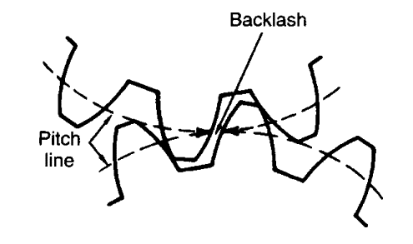
Backlash in Gears

Slide 25
Back Lash in Gears
Advantages:
a) Proper amount of back lash is given for smooth running of the gears.
b) No backlash means the gears need to manufactured with very high degree of accuracy.
c) Backlash provides better lubrication.
d) Prevents overheating and less noise
Disadvantages:
a) Backlash should be avoided in case of measuring instruments like lead screw, screw gauge etc. It results in error called backlash error.

Slide 26
Gear Trains
A gear train is a mechanical system formed by mounting gears on a frame.
when two or more gears mesh together to transmit power from one shaft to another such arrangement is called a gear set or a gear train.
Sometimes two or more gears are made to mesh with each other to transmit power from one shaft to another such a combination is called the “gear train of the wheel”.
Each gear is generally attached to a shaft often gears that are meshed together will be of different sizes, in this case, the smaller gear is referred to as the pinion and the larger one is simply referred to as the gear.

Slide 27
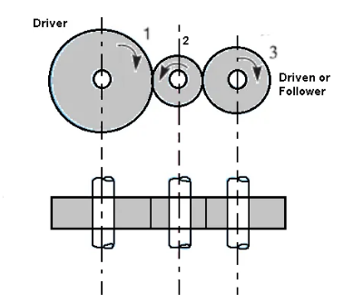
Simple Gear Train
The motion from one wheel to another is transmitted by providing one or more intermediate wheels.
When the number of intermediate wheels is odd, the motion of the driver and follower is in the same direction.
If the number of intermediate wheels is even the motion of the follower will be in the opposite direction of the driver

Slide 28
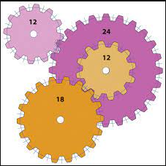
Compound Gear Train
In a compound gear train each intermediate shaft has two wheels fixed to it. These wheels have the same speed.
One wheel gears with the drier and the other wheel gears with the follower attached to the next shaft.

Slide 29
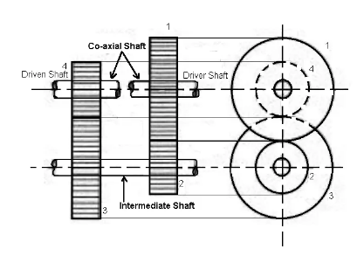
Reverted Gear Train
When the axes of the first and last wheels are co-axial the train is known as “reverted gear trains”.
Since the motion of the first and last wheel is alike, therefore a compound wheel is provided. Since the distance between the centers of the shaft 1 and 2 as well as 3 and 4 is the same.

Slide 30
Application of Gears – Working of manual transmission system
Manual transmission is the common and popular type of transmission used in vehicles. In this system, the driver must select gears manually by operating the gear stick and clutch.
The basic function of the transmission is to control the speed and torque of the vehicle in different driving conditions.
The manual transmission works on the principle of gear ratio. The gear ratio is the ratio of the number of turns made by the output shaft to the number of turns the input shaft makes once.

Slide 31
Application – Construction of manual transmission system
The gearbox consists of three main shafts:
Input shaft: The input shaft is connected to the engine crankshaft via the means of a clutch. Whenever the input shaft turns, the countershaft also rotates and is always in a fixed speed ratio.
Intermediate or lay shaft: This is connected to the input shaft and rotates at a constant speed. It rotates in the opposite direction to the input shaft. It continuously meshes with the input shaft and consists of several gears.
Output shaft: The function of the output shaft is to send the power out of the transmission system to the engine. It connects the countershaft to the driveshaft and probably to the wheels.

Slide 32
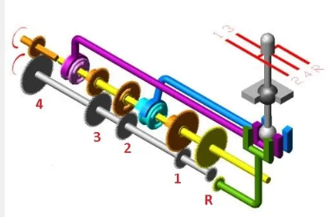
Application – Construction of manual transmission system
Orange = Input shaft
Yellow = Intermediate/lay shaft
Grey = Output shaft

Slide 33
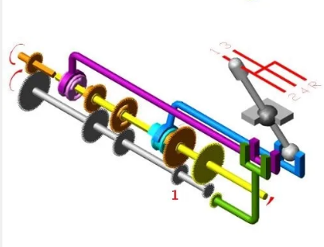
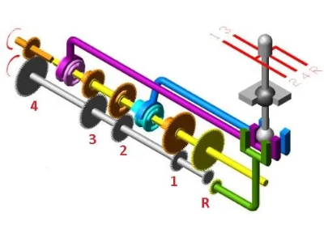
Neutral gear and First gear

Slide 34
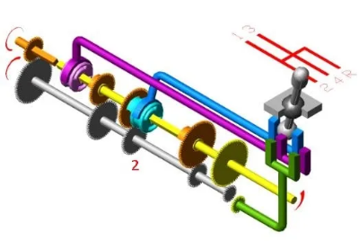
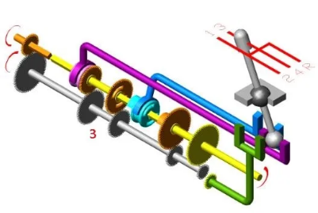
Second gear and Third gear

Slide 35
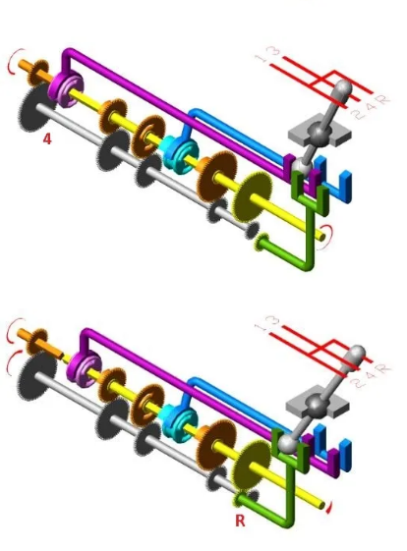
Fourth and Reverse Gear

Slide 36
Application – Construction of manual transmission system
In neutral gear, the vehicle remains stationary and there is no coupling attachment in the transmission which means no power is transmitted.
In first gear, the smallest gear on the layshaft (with the fewest teeth) is locked to it, passing drive through the largest gear on the output shaft, giving high torque and low speed for a standing start.
In second gear, the difference in diameter of the gears on the two shafts is reduced, resulting in increased road speed and lower torque increase. The ratio is ideal for climbing very steep hills.
In fourth gear, the input shaft and output shaft are locked together, providing 'direct drive': one revolution of the propellor shaft for each revolution of the crankshaft. The gear ratio is very high.
For reversing, an idler gear is interposed between gears on the two shafts, causing the mainshaft to reverse direction.

Slide 37
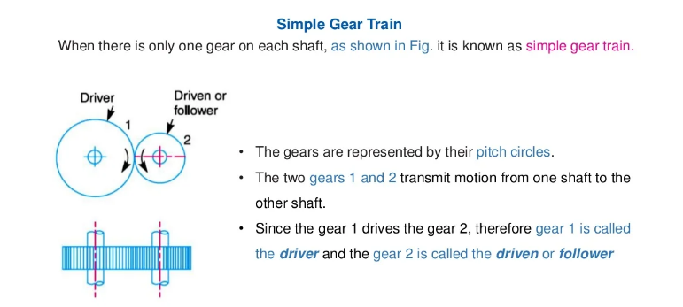
Speed Ratios and Train Values- Simple gear train

Slide 38
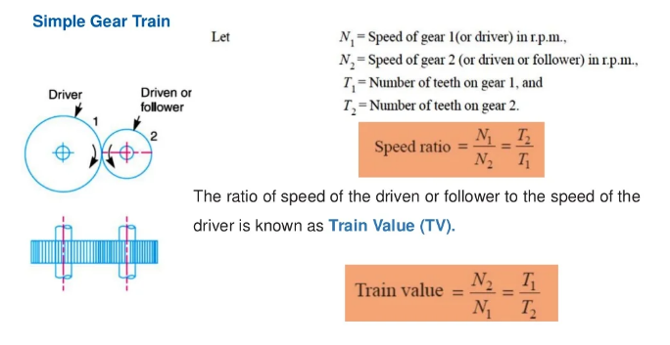
Speed Ratios and Train Values- Simple gear train

Slide 39
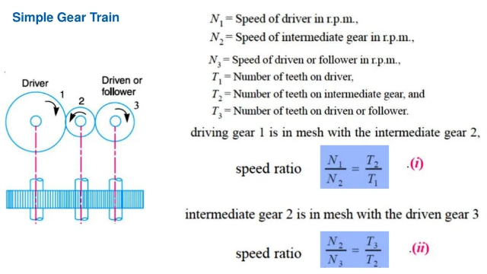
Speed Ratios and Train Values- Simple gear train

Slide 40
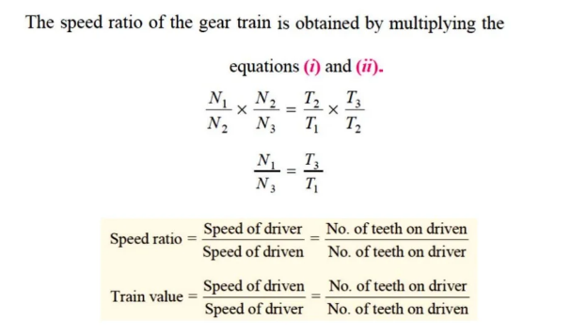
Speed Ratios and Train Values- Simple gear train

Slide 41
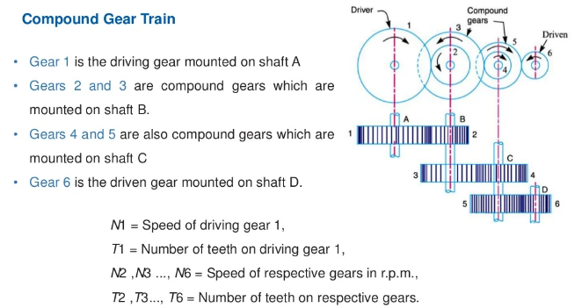
Speed Ratios and Train Values- Compounded gear train

Slide 42
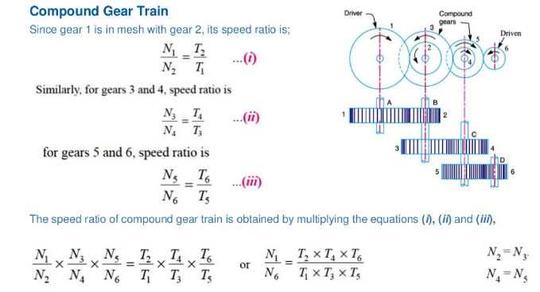
Speed Ratios and Train Values- Compounded gear train

Slide 43
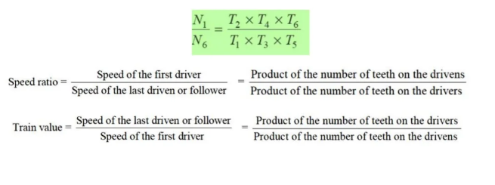
Speed Ratios and Train Values- Compounded gear train

